Slide 1
Optimizing the Video Streaming through Explicit QoE Analysis

Slide 2
Motivation
Heterogeneity
User:
User profile
QoE metrics (delay, stalling, bitrate), content
CDN:
CDN profile
QoE metrics
Performance
Fine-grained scheduling results in higher performance
Costs
Additional trade-off

Slide 3
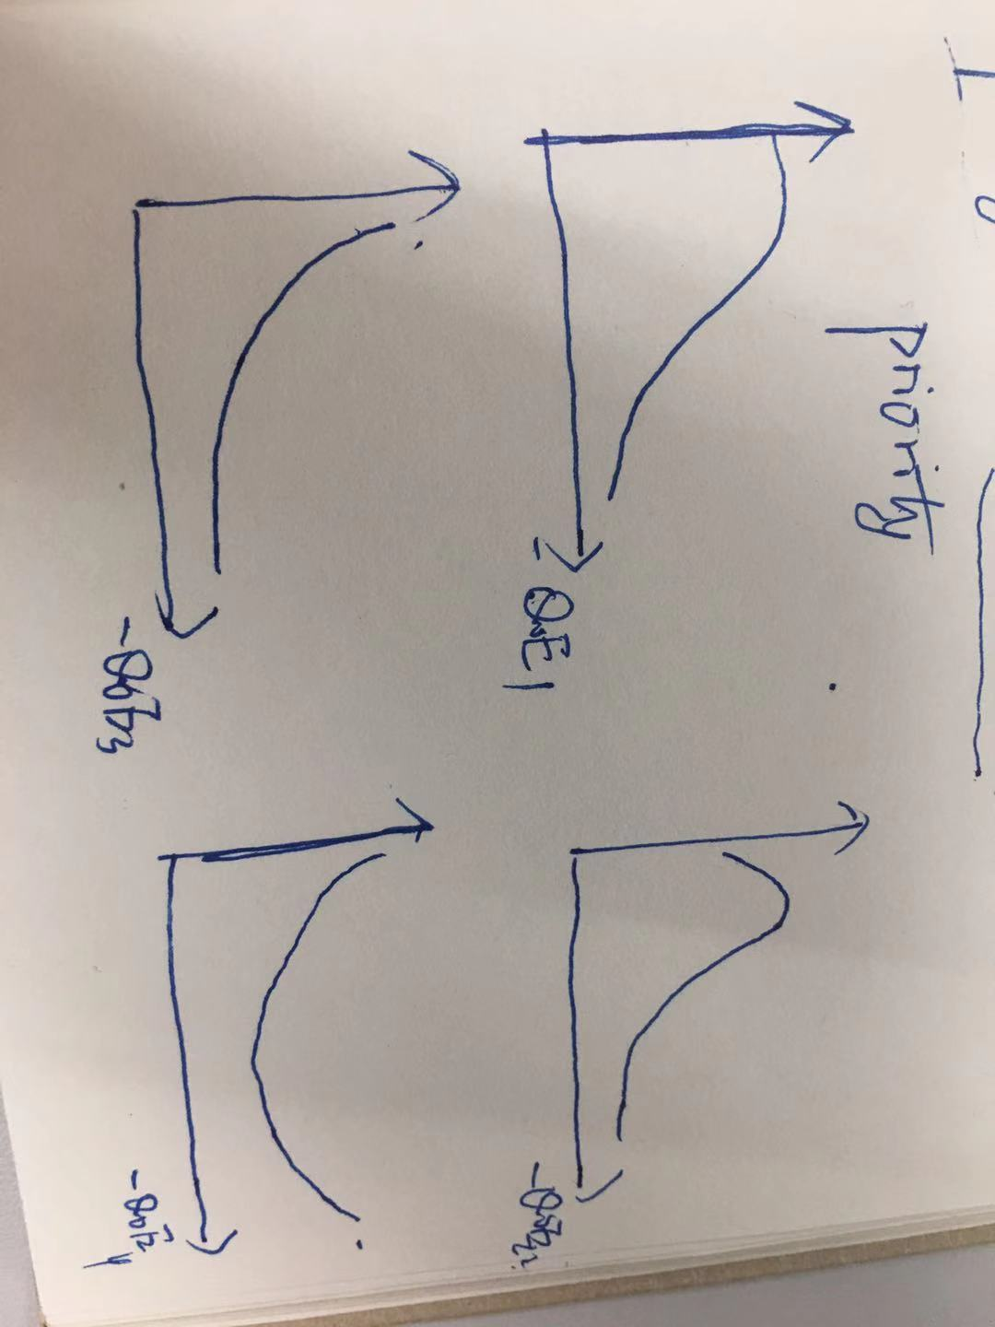
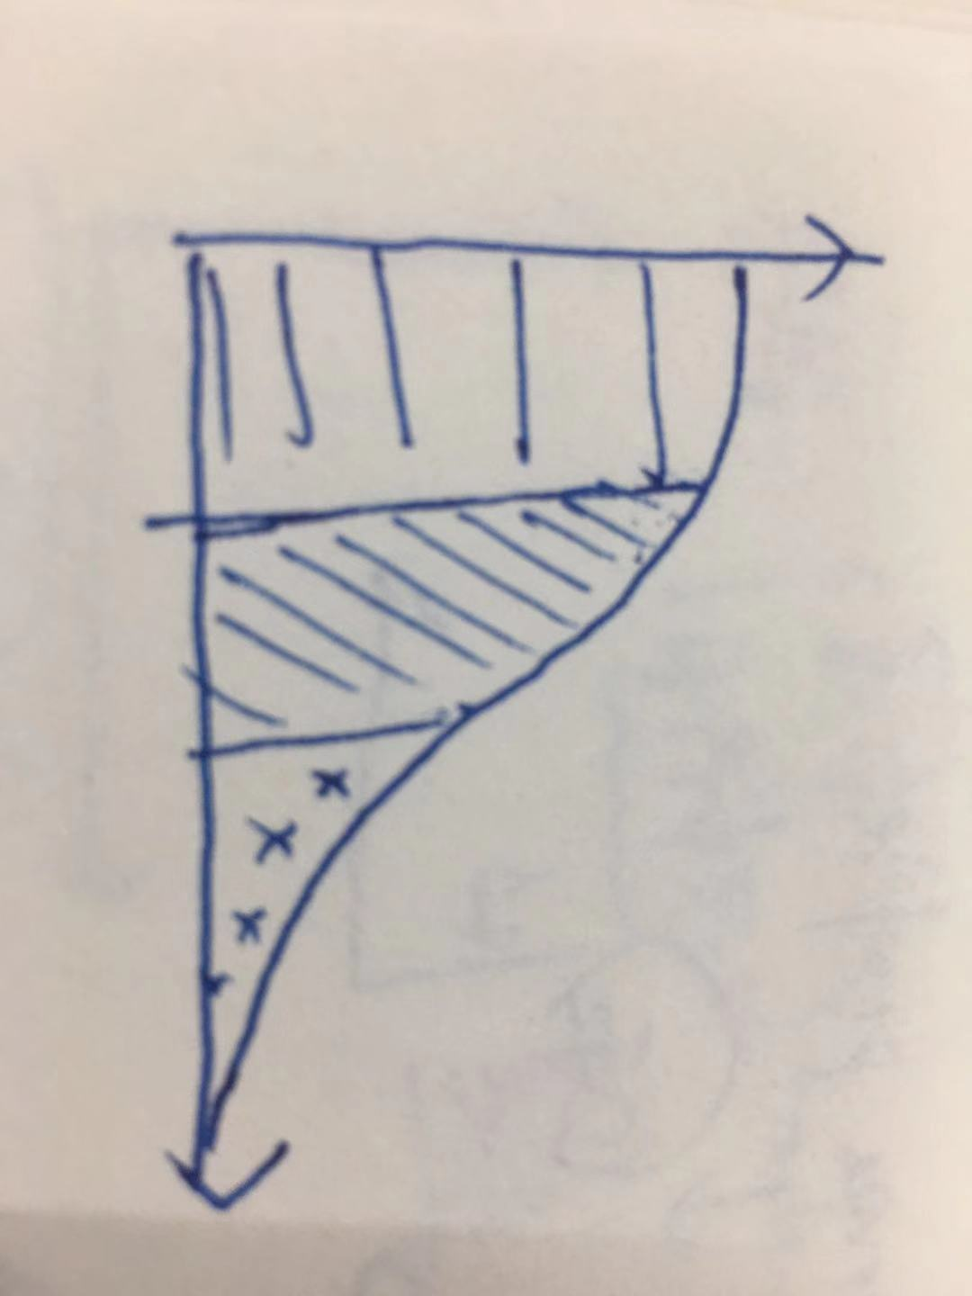
Motivation

Slide 4
Optimizing the Video Streaming through Explicit QoE Analysis
10/16

Slide 5
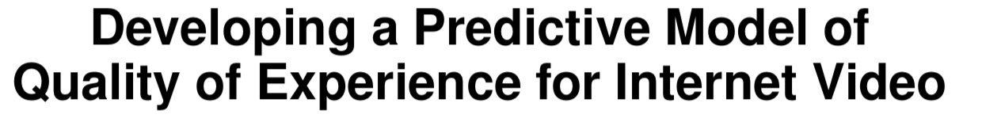
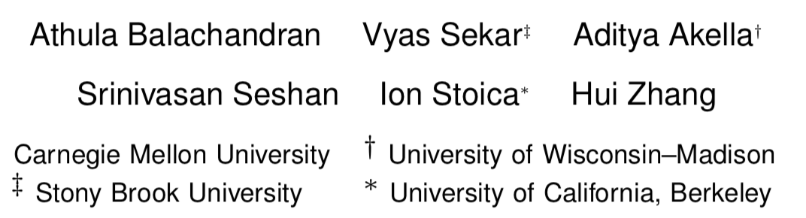

Slide 6
Motivation
Relationship between confounding factors and User Engagement
Complex relationship between quality and engagement
Dependencies between quality metrics
Confounding factors
it should be actionable to guide practical system design decisions.

Slide 7
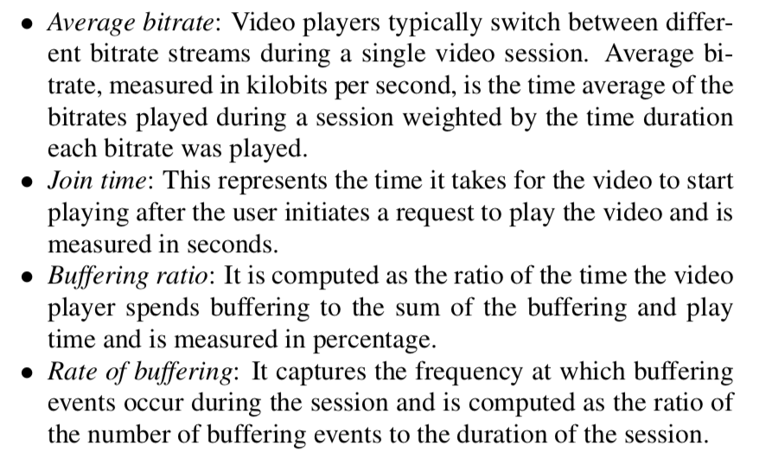
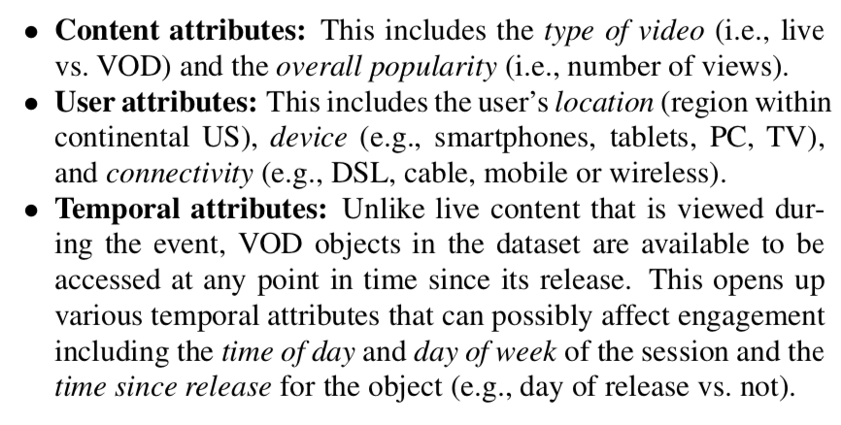
Metrics
QoS metrics
Confounding factors
No Interests

Slide 8
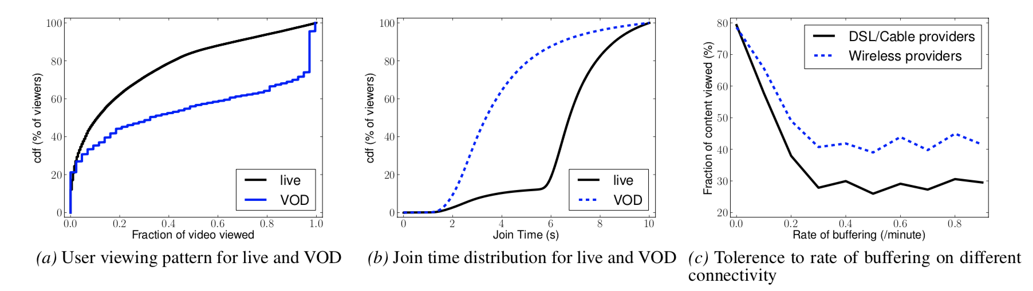
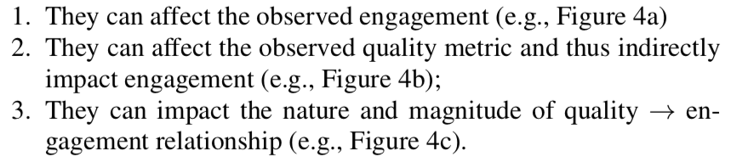
Insights

Slide 9
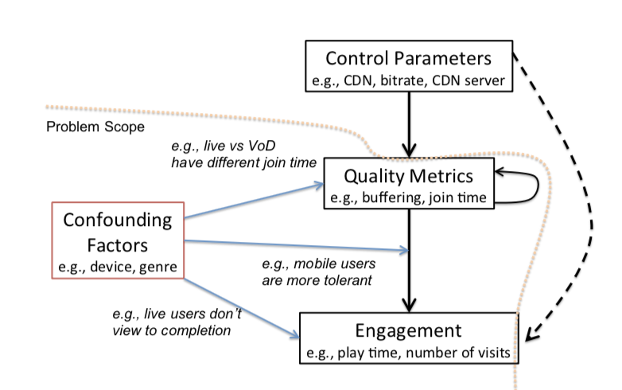
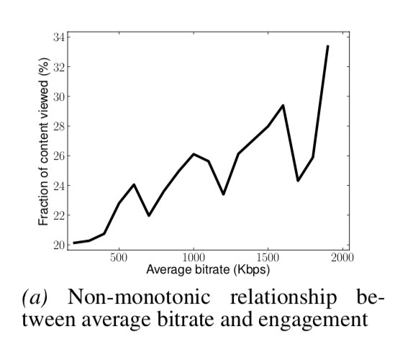
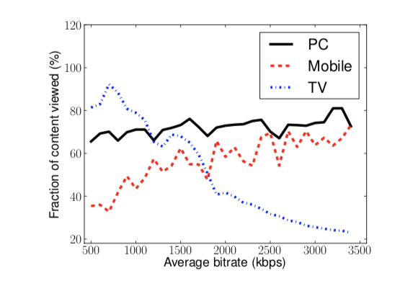
Insights
1. Decision Tree and Information Gain to estimate the relationship between QoS/Conf Factors.
1. QoS v.s Engagement after considering confounding factors
1. QoS v.s Engagement

Slide 10
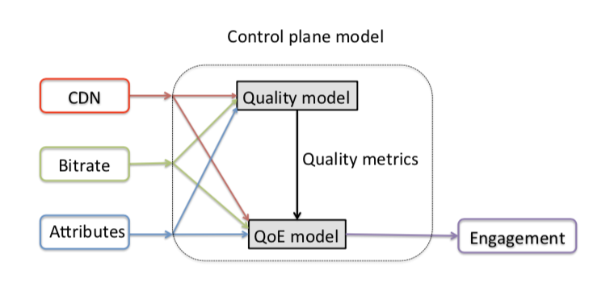
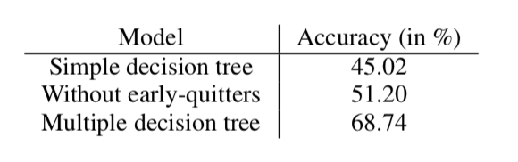
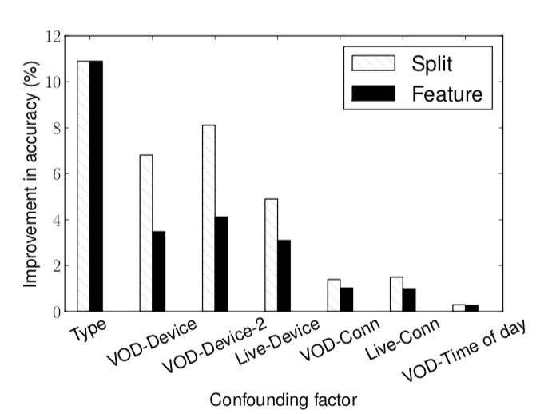
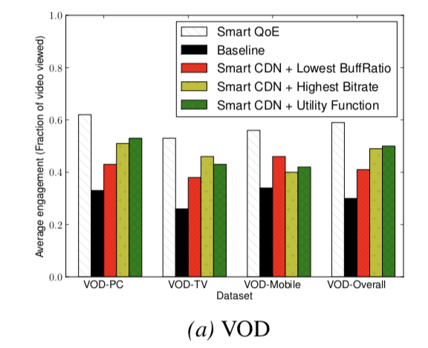
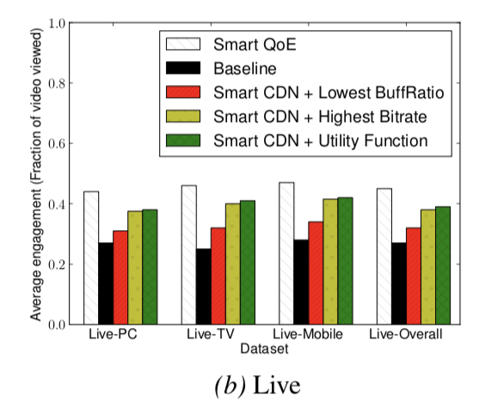
Results

Slide 11
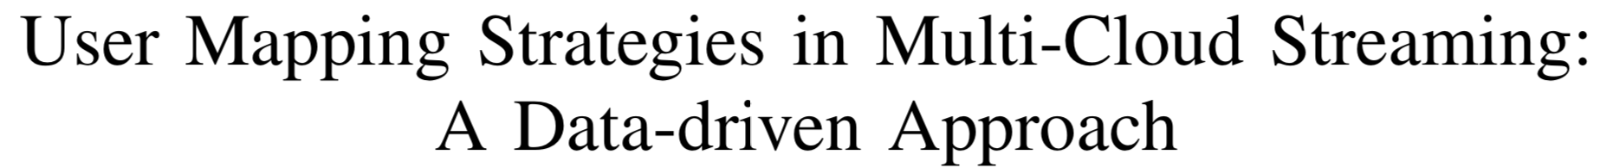
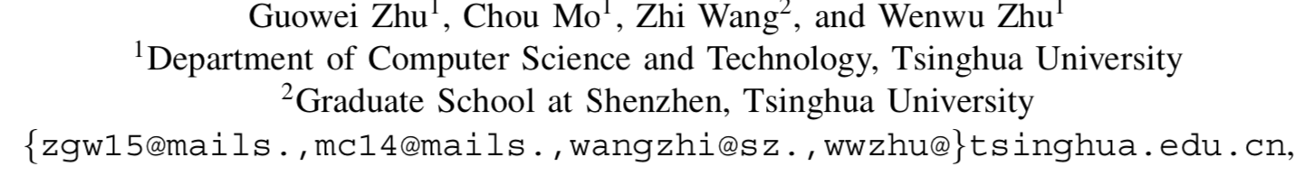

Slide 12
Motivation
First, rule-based user assignment cannot reflect the dynamics of the network performance
Only according to user’s location and hosting ISP.
Second, QoE in video streaming is affected by a variety of factors, including non-QoS factors.
QoS metrics: buffering ratio/rendering quality
User characteristics and behaviors
QoE-Aware CDN user mapping strategy.

Slide 13
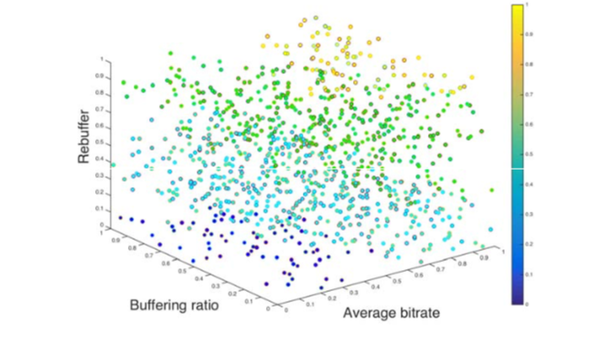
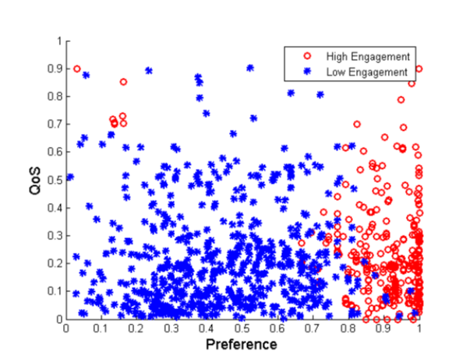
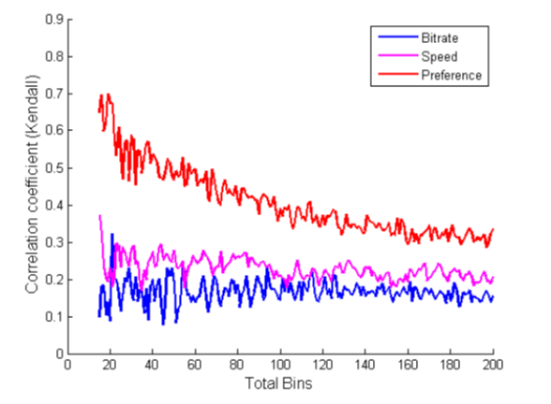
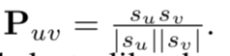
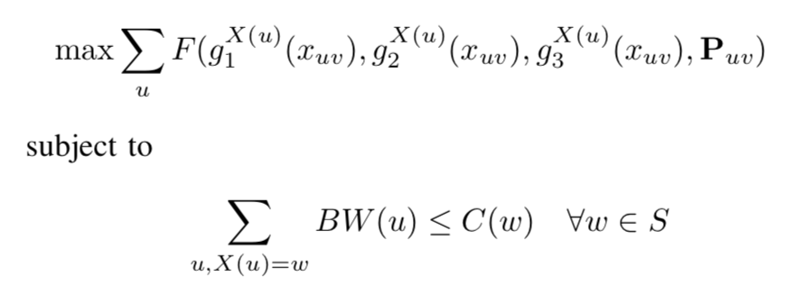
Design
1. Data-driven QoE mapping
Engagement is divided into two parts: high/low

Slide 14
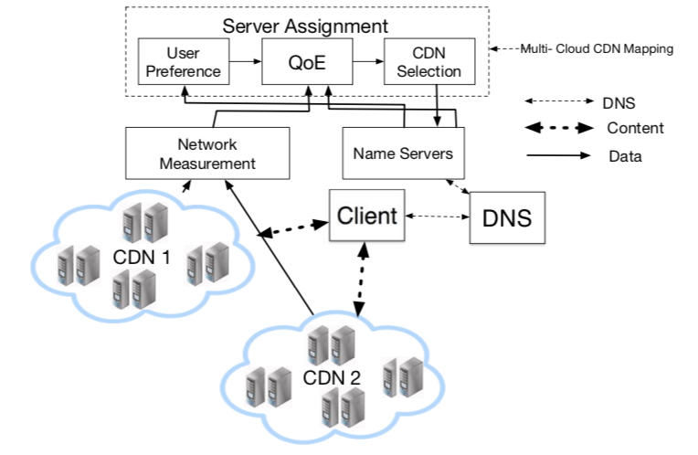
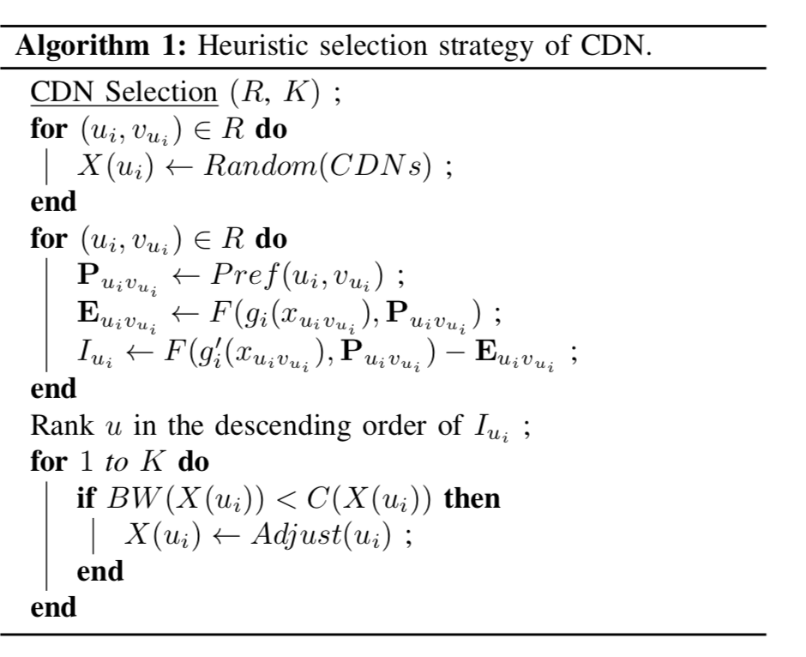
Design

Slide 15
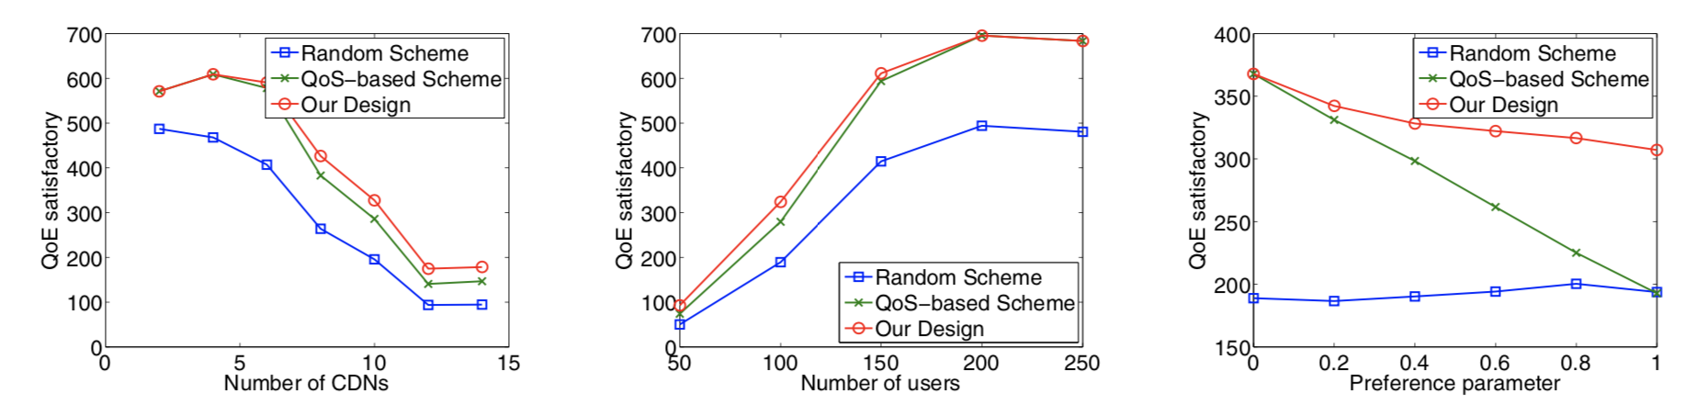
Results

Slide 16
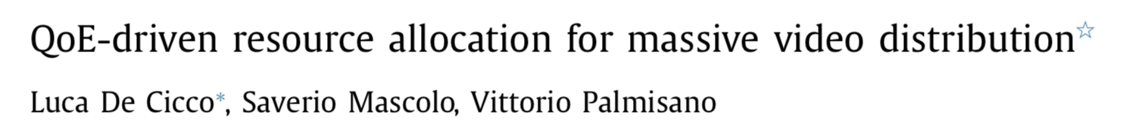

Slide 17
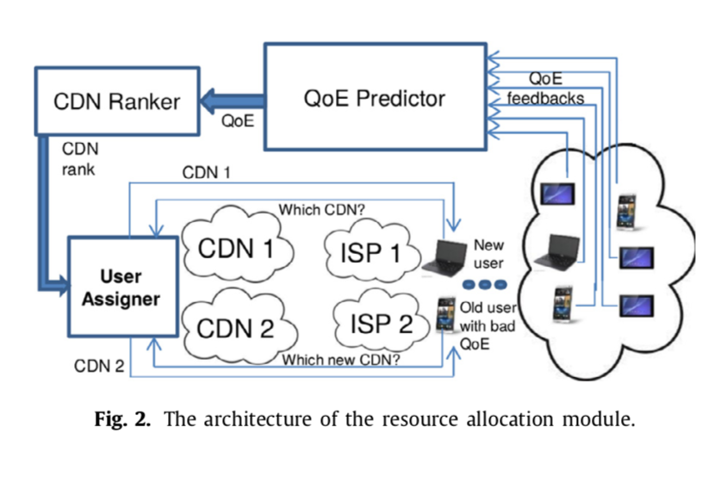
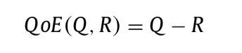
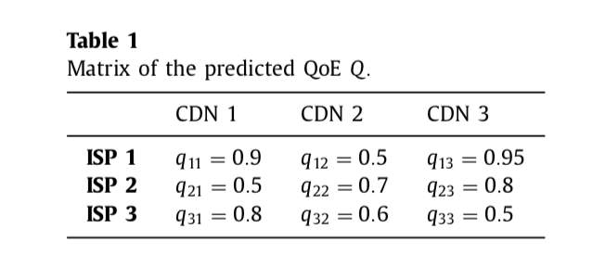
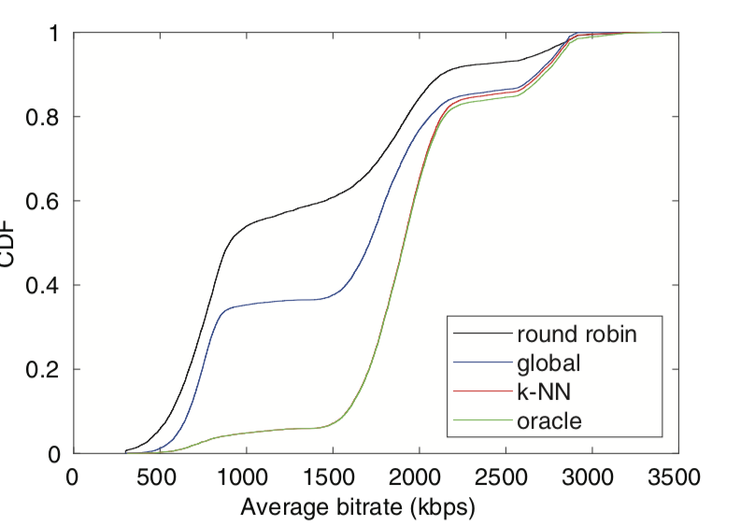
Design
Service: QoE predictor, K-means:
Client: DASH: ELASTIC

Slide 18
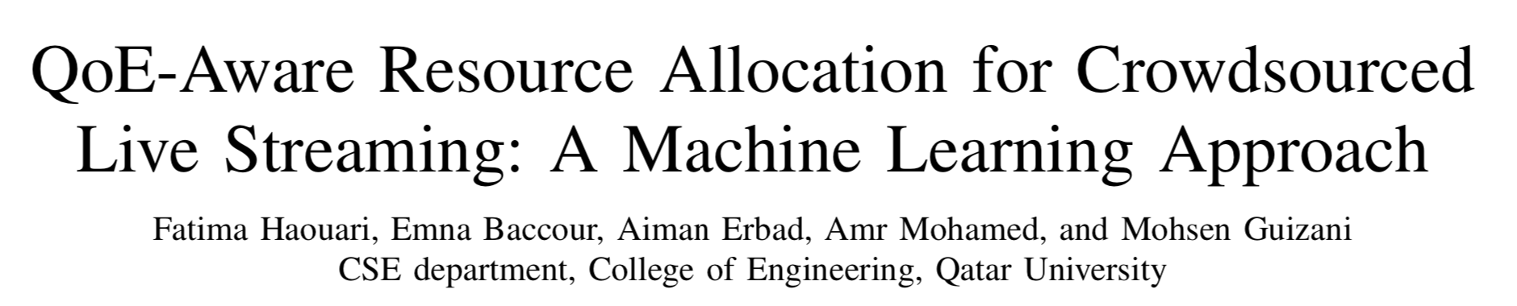

Slide 19
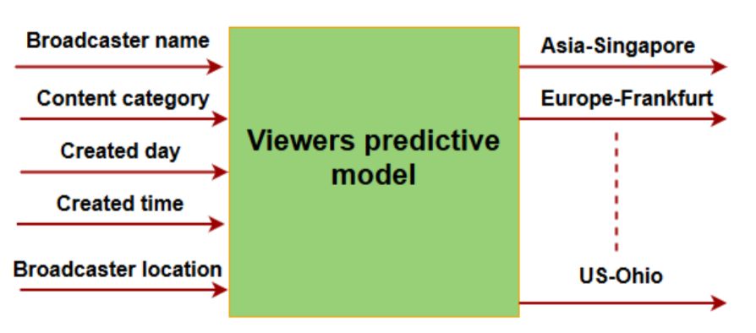
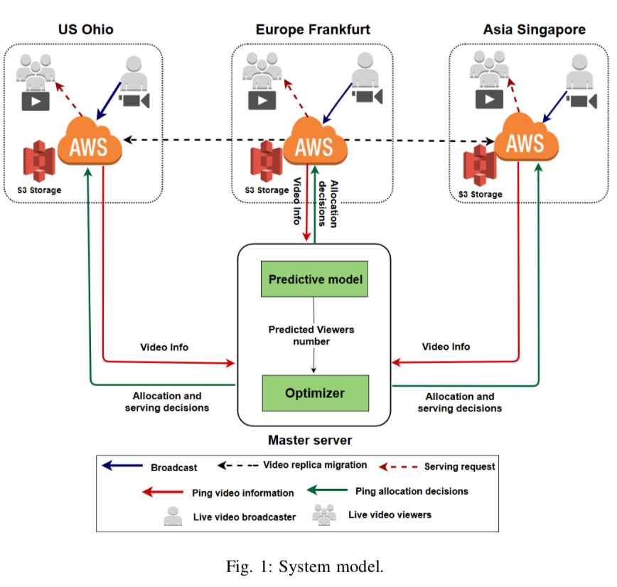
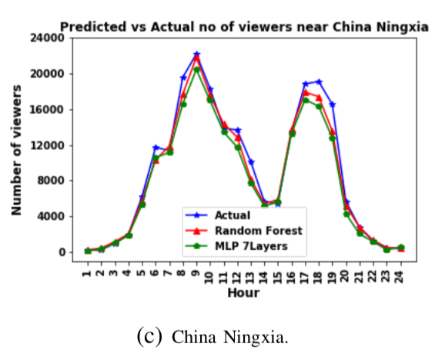
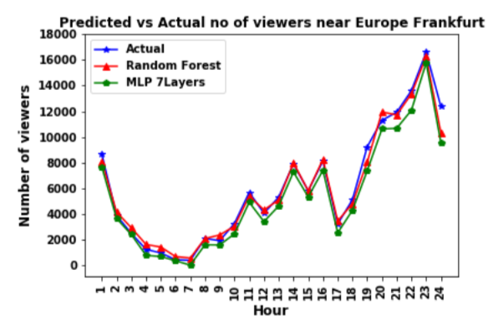

Slide 20
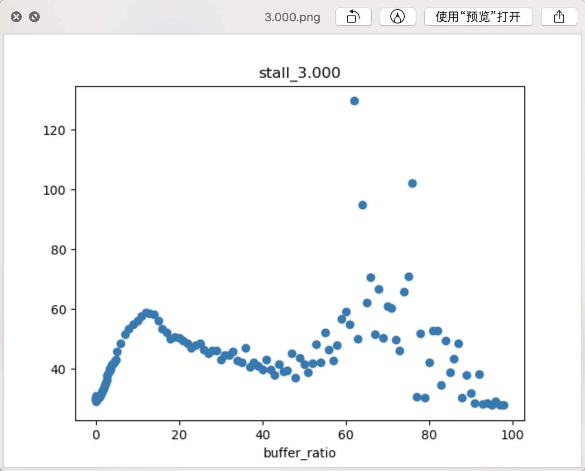
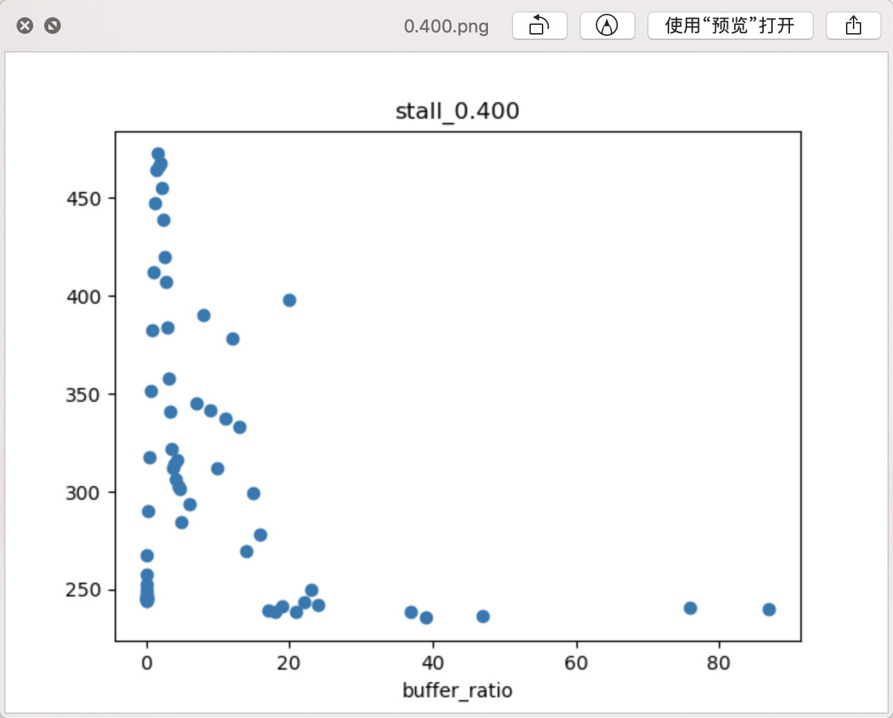
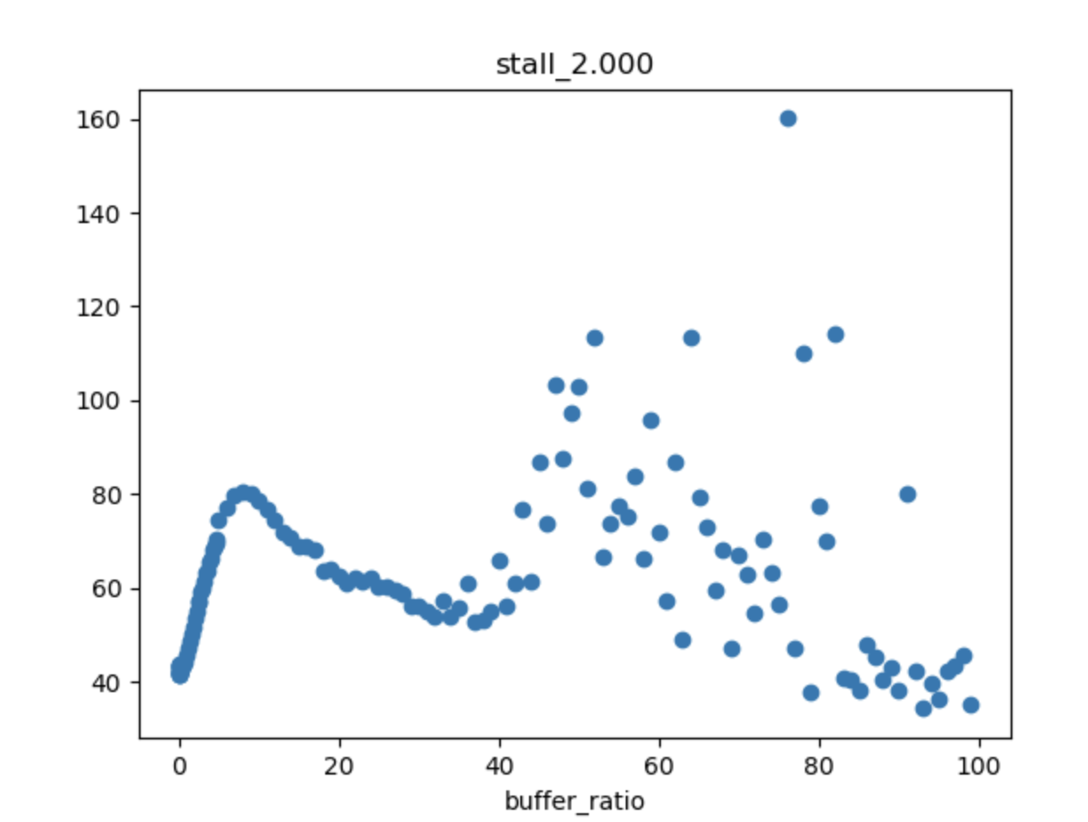
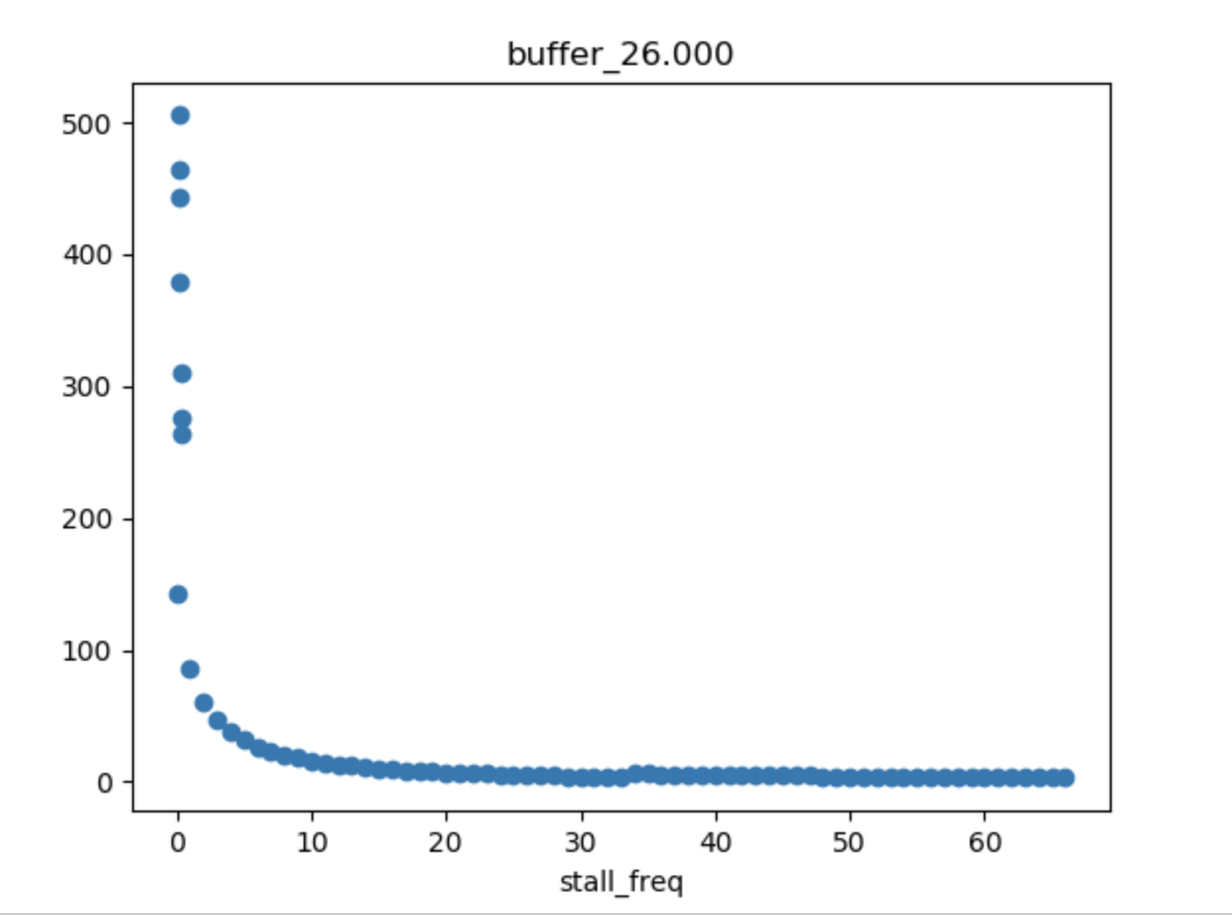
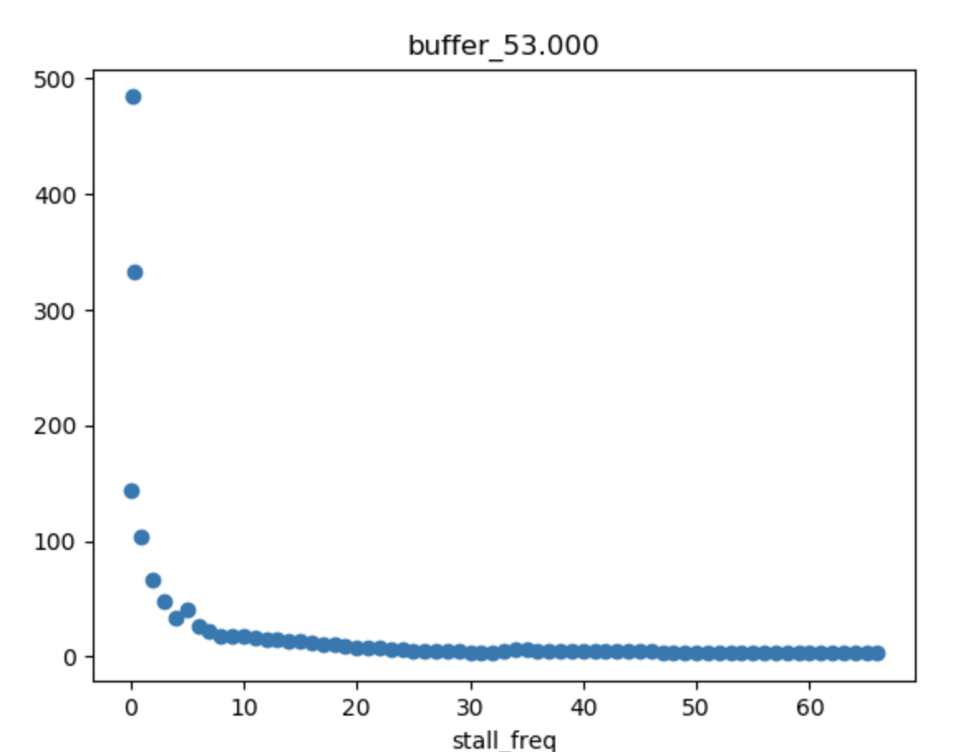
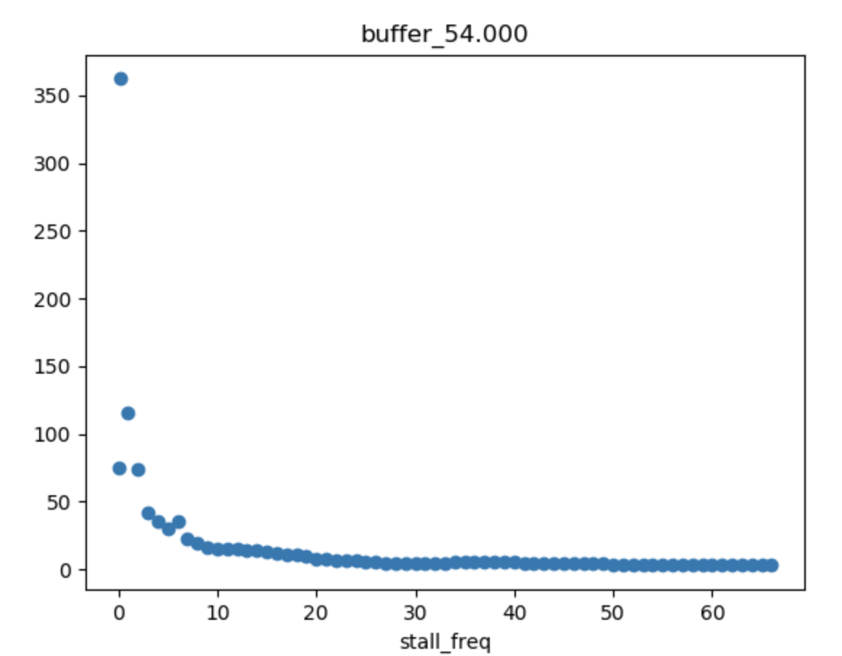

Slide 21
What’s the next
Heterogeneity → sensitivity
User:
User profile
QoE metrics (delay, stalling, bitrate), content
CDN:
CDN profile
QoE metrics
QoE
Data
Internship

Slide 22
Discussion
2019/10/31

Slide 23
Plan
1. TOMM: rewrite & extension
Enhancing the cls: a light-weight & interpretable approach
1) dynamic
2) long-term plan
3) interpretable (trouble-shooting)
3) light-weight (inference time, fine-grained scheduling)
2. Reactive Cache (Recycle to ICME)
3. QoE-Aware User scheduling for CLS: A distributed approach
4. QoE Modeling

Slide 24
Thoughts
2019/11/07

Slide 25
What I’ve done
1. TOMM: Keep writing & experiments

Slide 26
QoE-Aware User scheduling for CLS: A distributed approach

Slide 27
Motivation
1. The dynamics from CDN/Users
2. The requirements for different users are heterogeneous
Scheduling requests based on user preference. Fine-grained scheduling
3.

Slide 28
Challenges
1. Modeling user preference
2. The CDN performance is dynamic (time variant)
3. The users are co-related
Among new comers
New comers and remaining viewers

Slide 29
Methods
Two-step Scheduling:
1. User preference modeling
FM
…
2. Sequential/distributed scheduling
RL-based: state/action/reward
Scheduling without considering the influence, except when a CDN provider comes to its performance change point.

Slide 30
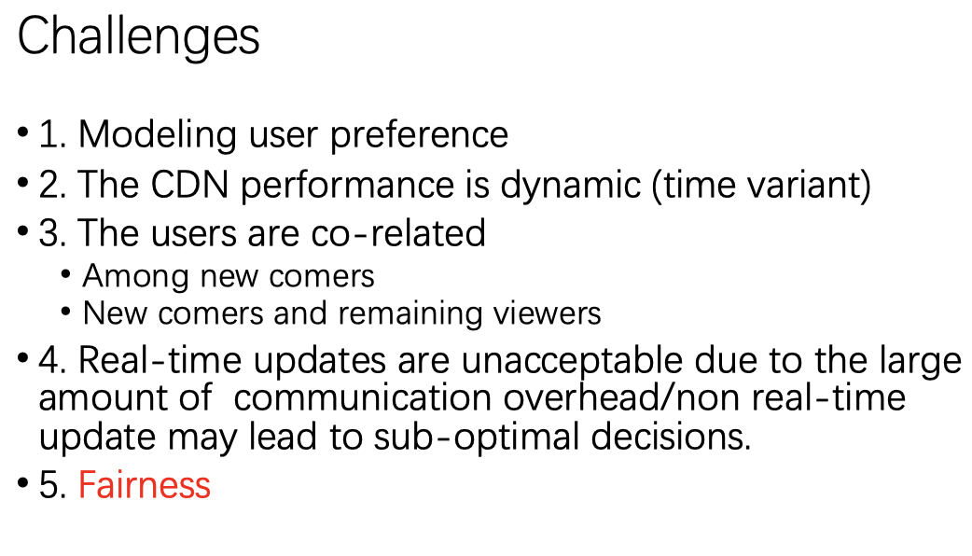

Slide 31
Thoughts
2019/11/07

Slide 32
Motivation
1. The dynamics from CDN/Users
2. The requirements for different users are heterogeneous
Scheduling requests based on user preference.
3. Fine-grained scheduling.

Slide 33
Challenges
1. Modeling user preference (multi-factor)
2. CDN performance dynamics (temporal, workload-related)
3. The users are co-related
Among new comers: global view
New comers and remaining viewers: two-step
4. client-based: Real-time scheduling is unacceptable due to the large number of communication overhead/
5. Server-based: Computation overhead

Slide 34
Method
Two-step scheduling
Modeling
User modeling: 1) Measurement 2) FM-based preference modeling
CDN performance modeling: 1) temporal 2) workload-related
Scheduling
Server-based
Client-based

Slide 35
Scheduling: server-based (similar to E2E)
Prediction → Course-grained allocation → Fine-grained assignment
1. Prediction: future workload
2. Course-grained allocation: greedy search to best allocation ratio. Rationale since the CDN performance is only related to workload, not related to which requests are served. (keep CDN performance stable?)
3. Fine-grained assignment: Graph mapping problem (Considering User preference)

Slide 36
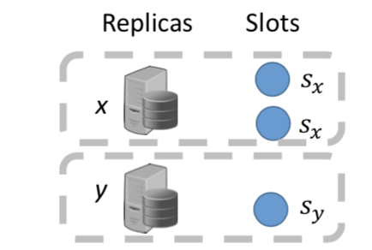
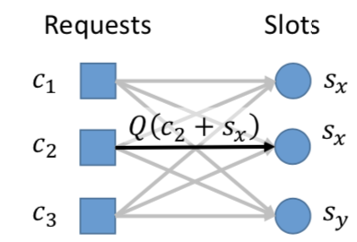
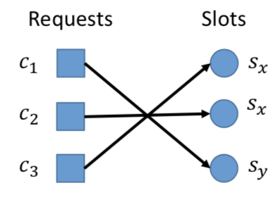
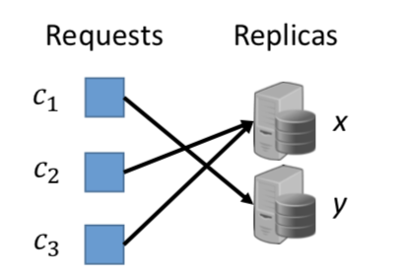

Slide 37
Expectations:
Pros:
global information;
somehow considering the correlation. remaining : 1. ; new: 2/3
CFA: no considering of the user preference Pytheas: no considering of the correlation. E2E: preference model (multi-factor); Clustering.
Cons: overhead (clustering ? Can FM still work?) / long-term entertainment (1), different from E2E (Maybe measurement can support?)

Slide 38
Nips 2019
2019/12/19

Slide 39
Outlines
Multi-agent:
learning fairness in multi-agent systems
Efficient Communication in Multi-Agent Reinforcement Learning via Variance Based Control
General RL:
Fast efficient hyperparameter tuning for policy gradient
policy continuation with hindsight inverse dynamics
Better Exploration with Optimistic Actor-Critic
Fast-forward:
…

Slide 40
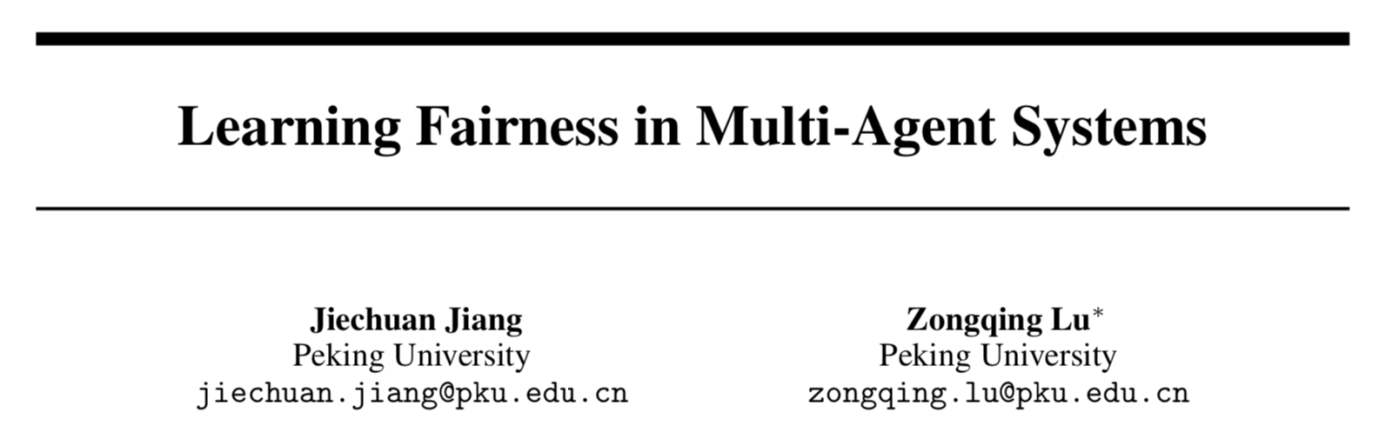

Slide 41
Motivation
1. Fairness is important in real-world scenarios (routing, traffic light control, cloud computing)
2. Efficiency and fairness are counterfactual
3. The problem is complex (Multi-objective)

Slide 42
Method
1. FEN (Fair-efficient network)
2. Decompose fairness for each agent and propose fair-efficient reward.
3. hierarchy specifically designed for easing the learning difficulty.
4. Decentralized training
5. fixed number of agents.

Slide 43
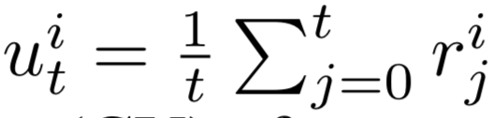
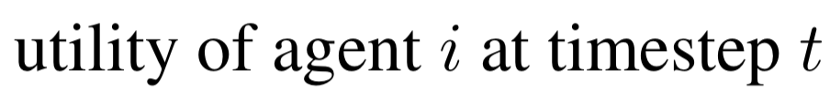




Fair-efficient reward

Slide 44

Hiearchy
A controller and several sub-policies parameterized by \theta and \phi
Outputs: controller selects sub-policy, sub-policy interacts with environment
Training reward: Controller optimizes the real reward, sub-policy optimizes efficiency or fairness.
Controller updates in a coarse-grained manner, while sub-policy updates in a fine –grained manner.

Slide 45


Training
Gossip-based communication
The gossip algorithm is distributed and requires only limited communication between neighbors to estimate the average.

Slide 46


Results

Slide 47


Slide 48
Motivation
1. Communication is necessary: MDP
2. Communication is efficient and even harmful
1. communication overhead
2. wrong messages

Slide 49
Background
1. IQL: Independent q-learning
2. VDN: Value Decomposition Network
3. QMIX: Uses a DNN to represent the joint action q-value
4. COMA: A learnable message

Slide 50
Method
1. QMIX-based: Centralized training and de-centralized execution
2. Use hidden info as the communication messages (GentleDASH)
3. Variation-regularized loss function
4. Variation-based communication protocal

Slide 51

QMIX-based structure
Parameter shared
Hidden-state communication
QMIX

Slide 52

Loss function definition
First part: standard supervise
Seconde part: limit the variance of the messages from other agents

Slide 53

Variation-based communication protocal
1. Request-based: active
2. Whether request communication? Confidence of its action
3. Whether accepting the message? Information

Slide 54


Results

Slide 55


Slide 56
Motivation
Hyper-parameters are quite important in RL training
Fixed parameters are sub-optimal
Widely used grid search methods for tuning are sample-inefficient.
Gradient based method: sensitive to the choice of their own hyper-parameters or non-differentiable.

Slide 57
Method
1. Generate policy candidates by using different hyper-parameter settings (learning rate / Gamma / GAE / TRPO \sigma), policy gradient.
2. Estimate their value sample efficiently by using an off-policy method
3. Update the policy greedily with respect to the estimated value of the candidates.

Slide 58




HOOF
When updating policy, no needs for calculating FIM (different from TRPO). Evaluation and reject improper update

Slide 59


Results

Slide 60


Slide 61
Motivation
Goal-based RL problems are receiving more attentions.
Difficult since the rewards are often sparse.
Previous methods (e.g., HER) suffers improper goal direction.

Slide 62
Method
1. Policy continuation
2. hindsight inverse dynamics:
3. Multi-step hindsight inverse dynamics

Slide 63

Policy continuation
Purpose: A policy with PC property can handle multiple policy functions (multi-step goal based)

Slide 64


Hindsight inverse dynamics (HID)
One-step:

Slide 65


Multi-step HID

Slide 66


Test

Slide 67



Combining PCHID with other RL

Slide 68


Results

Slide 69
Thoughts
From RL perspective: a good regularization method
Different from RL: different goals may introduce different
Can it be used into DASH problem?
Goal-oriented method: higher bitrate/ lower rebuffer/ lower fluctuation
How to define goal with state? Recurrent?

Slide 70


Slide 71
Motivation
1. Model-free RL suffers from the data inefficiency.
2. Nowadays methods suffer from pessimistic underexploration problem (i.e., trapped into sub-optimal region)
3. current algorithms are directionally uninformed: sampling actions with equal probability in opposite directions from current mean.
Continuous control problem
Notes:
Efficiency consists of two aspects: 1. better exploration 2. better utilization of off-policy data.

Slide 72

Background
SAC & TD3:
Critic Network is used to computes an approximate lower confidence bound for value.
The actor network then adjusts the exploration policy to maximize this lower bound
Greedily maximizing the lower bound, the policy becomes very concentrated near the suboptimal. Harmful when the Q estimation is unreliable.

Slide 73





Method
1. Obtains an exploration policy Pi which locally maximizes an approximate upper confidence bound of Q. (separate from the target policy Pi_T)
2. Optimizing the problem using the KL constraint.

Slide 74


Solve the above:
Note: Only discuss exploration, the update still uses the minimum form, therefor, it won‘t suffer overestimation problem

Slide 75

Results

Slide 76

Fast-forward

Slide 77

Intro
1. Model free method is cost-inefficient
2. off-policy method needs too much data and suffers great variation.
User behavior model
Environment model

Slide 78


Slide 79


Slide 80


Slide 81


Slide 82


Slide 83


Slide 84


Slide 85
Future of RL (from Kartia)
1. Sample-efficiency:
1. model-based RL
2. better exploration
3. off-policy method
2. Meta learning:
1. Using data from related tasks to rapidly adapt to new tasks
2. Using more (known) human prior
3. Multi-agent RL (different from Silver):
Better training method
Communication

Slide 86

Sutton

Slide 87


DaLao

Slide 88



HuiChang

Slide 89




Chi

Slide 90


Slide 91
Thoughts
2019-12-26

Slide 92
NOSSDAV’20
1. An application-layer Multi-player coordinated DASH
2. Object:
3. MPC-based / Buffer-based solution:
MPC: overall throughput, buffer, maximize the objective
Buffer-based: Multi-queue stabilizing (BOLA), Lyapunov optimization, bound proof (Multi-user cooperative Mobile video streaming)
4. A real-world demo

Slide 93
Multi-agent DASH
Finish: Environment: packet level → Chunk level, as fast as Pensieve
To do:
Some heuristic algorithms (NOSSDAV)
QoE measurement
GentleDASH
Problems：
Settings
Bandwidth estimation

Slide 94

Settings
1. Multi-user cooperation is necessary (Bentalab). Users need to share information with each other. (Centralized / Communication and decentralized excution)
2. Use a DASH Server (Minerva) to communicate

Slide 95


Bandwidth estimation
Obj: Estimate the overall throughput
Problem: local observation → reconstruct the overall throughput
Possible solution: Server based, Keep track of all client states, Keep alive, deliver when any client takes action

Slide 96
Paper Reading
2019/12/5

Slide 97


Slide 98

Motivation
1. First, there is a major conflict between the enormous sample space and the limited capacity for subjective QoE measurements. (Argue Data-driven method).
2. Second, the learning-based models assume that the training samples and testing samples come from the same distribution
Given a collection of subjective QoE studies, how do we make use of the knowledge in a principled and scalable manner?

Slide 99


Methods
S / A are not well studied

Slide 100




1. The influence of each rebuffering event is independent
2. rebuffering is negatively correlated with the overall QoE of streaming videos,
3. QoE drop tends to be greater when the presentation quality of the previous chunk is higher
4. given a constant presentation quality and a fixed total duration of rebuffering, the overall QoE degrades as the number of rebuffering occurrences increases
5. given the same rebuffering duration, videos with higher presentation quality consistently deliver higher overall QoE, despite the greater penalty for the rebuffering event

Slide 101




we first assume that the in- fluence of each quality adaptation event is independent and additive, and only depends on the instantaneous presentation quality p, and the intensity of the adaptation ∆p
A must have the same sign as the quality adaptation ∆p
the relationship between the QoE adjustment A and the intensity of quality adaptation ∆p indicates that subjects tend to give greater QoE penalty or reward when quality drops or improves by a greater amount

Slide 102

The presentation quality model should provide meaningful and consistent QoE predictions across video contents, video resolutions, and viewing conditions/devices.
SSIMplus
VMAF

Slide 103





Linear approximation
Discretization
Vecterization
Smoothness of Function
Smoothness regulation

Slide 104






Slide 105

Results

